Slide 1
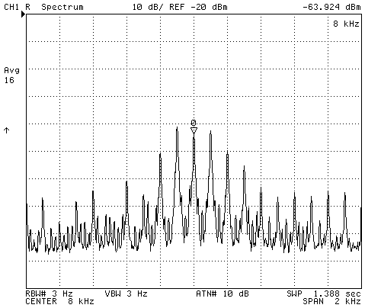
8 kHz perturbations, investigations and follow-up for the transverse damper system (ADT, Point 4)
D. Valuch, R. Louwerse, W. Höfle (BE/RF)
thanks to V. Chareyre, A. Funken (EN/EL)

Slide 2
The transverse damping system (ADT)
Powered by UPS in SR4
Powered by UPS in SR4

Slide 3
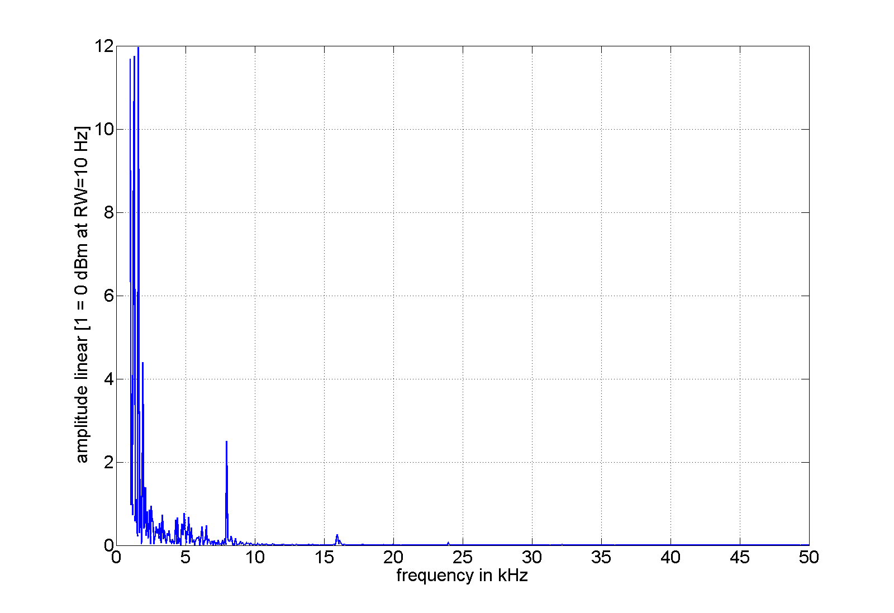
ADT kicker voltage measurement (Nov. 2009)
The 8kHz line on the HOM return was observed already
before the whole “8kHz story” unfolded (29/11/2009).
We were to further investigate nature of the line.
strong line at 8 kHz already observed

Slide 4
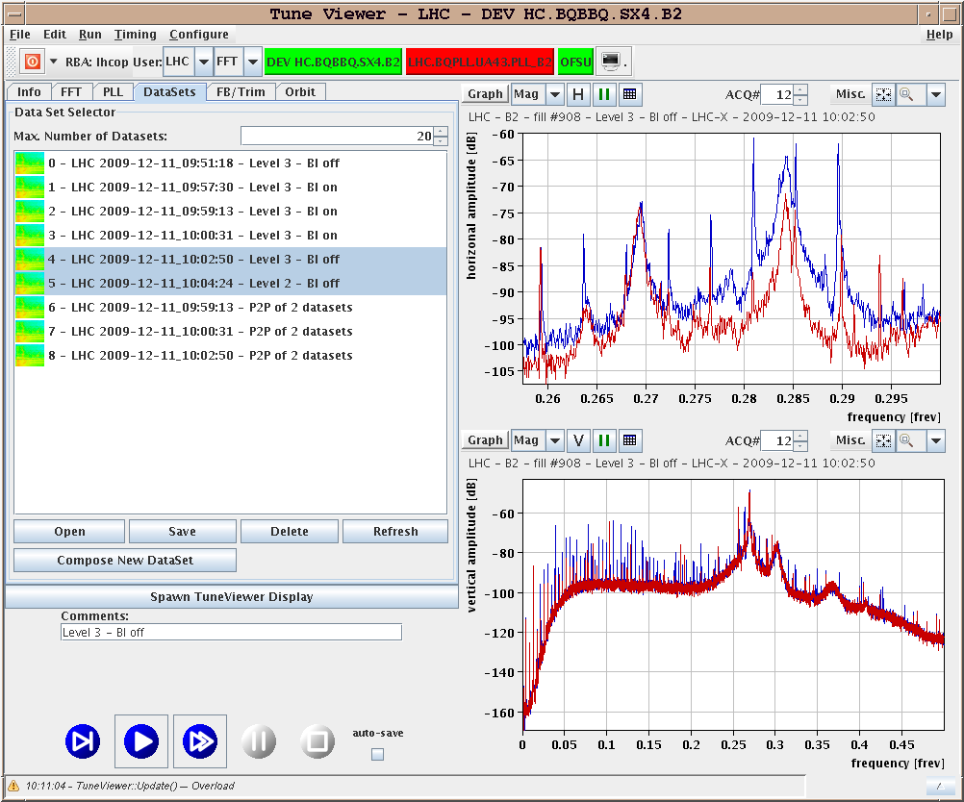
BBQ tune measurement (Dec. 2009)
The BBQ measurement in December 2009 proved that the 8kHz line previously seen on the kicker is not only a measurement artifact.
8 kHz + ~50 Hz lines
ADT ON (blue)
ADT OFF (red)
11. December 2009
Fill #908. See the LHC Log Book

Slide 5
ADT drive signal
We have found the 8kHz signal in our signal chain:
8 kHz
16 kHz

Slide 6
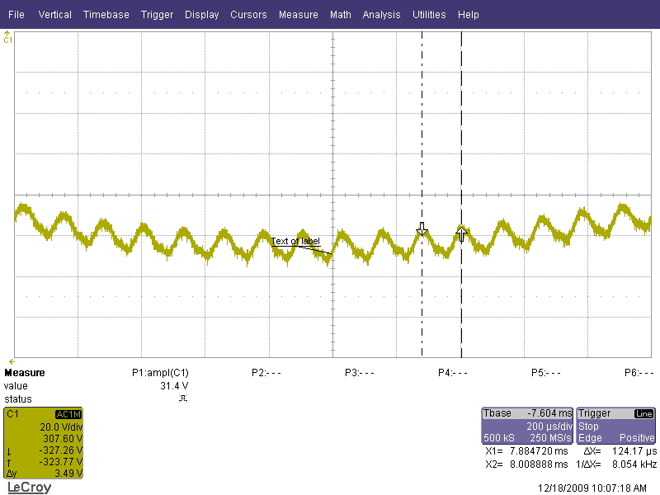
Finding the suspect
The 8kHz frequency was noticeably similar to the audible noise generated by the UPS (both the SR4 and UX45)
Measurements of the mains voltage showed 8kHz (+harmonics) pollution on both no-UPS and UPS power distributions
8 kHz
Phase to Neutral:
~8V@8 kHz on top of the 230V
16 kHz
Measurement by
V. Chareyre EN/EL

Slide 7
Measurements and observations in UX45
By switching off the UPS in the UX45 and SR4 the 8kHz line and the forest of harmonics disappeared
The 16kHz line was untouched – the signal must come from elsewhere
Switching back ON the UX45 UPS introduced some 8kHz
Switching back ON the SR4 UPS brought in significant interference
UPS in the SR4 is the main source of the 8kHz for ADT…

Slide 8
Measurements and observations in UX45
UX45+SR4 UPS ON
Both UPS OFF

Slide 9
Measurements and observations in SR4
The 8kHz signal is product of the APC UPS pulse-width-modulator switching
Measured pollution (~8V@8kHz on 230V) is well within the UPS specs (<5% Total Harmonic Distortion)
Investigation show that for ADT the problem is most likely linked ground currents

Slide 10
Measurements and observations in SR4
We have ~90mA@8kHz leaking from the ADT racks in SR4 !
Leaking Common Mode (CM) ground currents introduce a differential voltage on our coaxial lines driving equipment in UX45
Large ground cable loops induce also lot of 8kHz magnetic field in the building (radiated emission)

Slide 11
Measurements and observations in SR4

Slide 12
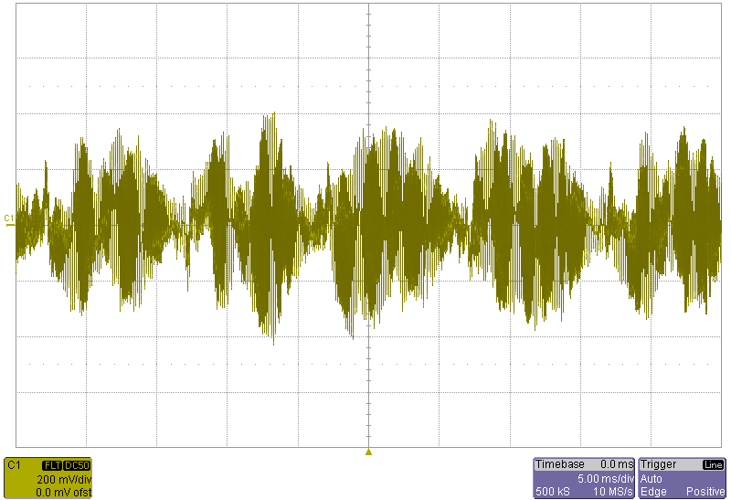
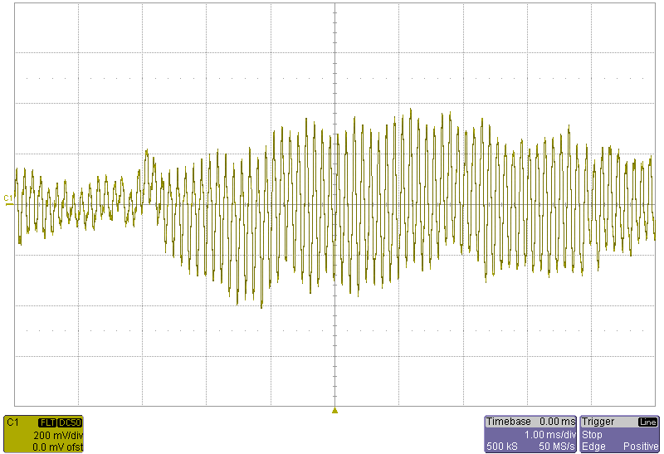
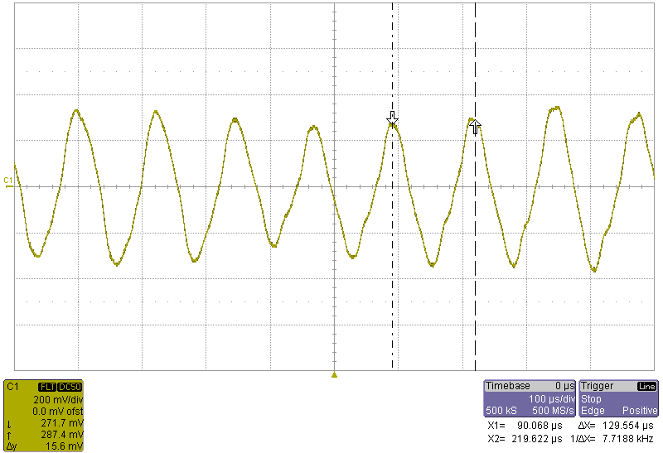
Measurements and observations in SR4
Leakage current from the previous slide displayed in time domain.
The 8kHz current has a 50Hz structure

Slide 13
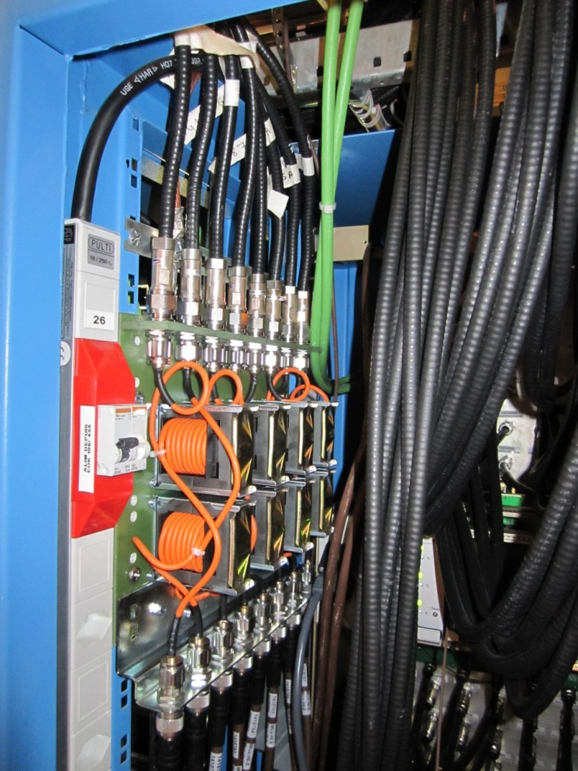
“Emergency” remedy for the ADT
The 8kHz currents could be measured in each piece of conductor between any points in the ADT racks (coaxial cables, ground bars, rack structural components)
Modifications* applied to the ADT during the winter LHC shutdown:
  Inserted common mode chokes (~5mH or 250Ω@8kHz) on all 16 coaxial lines connecting SR4 and UX45 ADT equipment. >10dB suppression @8kHz, >20dB @16kHz
  Modification of the signal levels, further 10dB improvement (wideband, only differential mode)
  Modified grounding connections for some sensitive equipment
* Everything what was possible to do with a reasonable effort within the winter shutdown

Slide 14
“Emergency” remedy for the ADT
Signal level modification should provide further wideband improvement by 10dB

Slide 15
December 2009

Slide 16
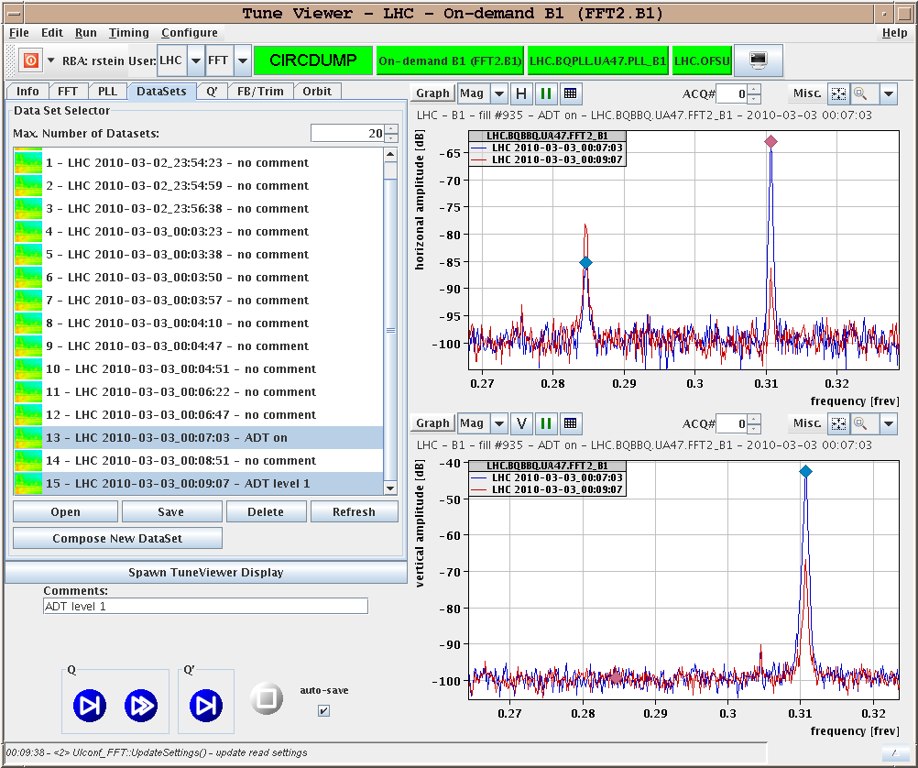
March 2010
Beam time needed to do more measurements

Slide 17
Suggested further follow-up of the problem
The level of UPS input/output filtering and the quality of grounding in SR4 in not compatible with the ADT installation.
Test with beam needed to see if the current modifications are sufficient
Install filters on the 230/400V in/out buses. Preferably the filter should dissipate the 8kHz component instead sending it back through the grounding system
Significantly improve grounding in SR4, at least the piece between the transformer and the UPS must still have sufficiently low impedance at 8kHz
Change the UPS for one with lower emissions, at least the one in SR4.
Radiated emissions may be cured by changing the UPS

